Slide 1
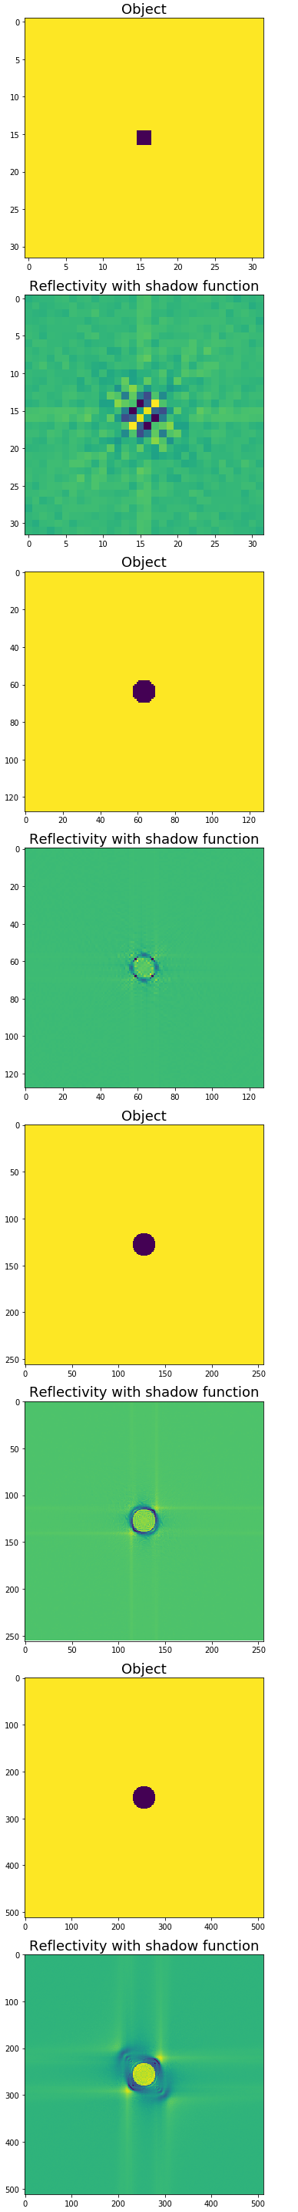
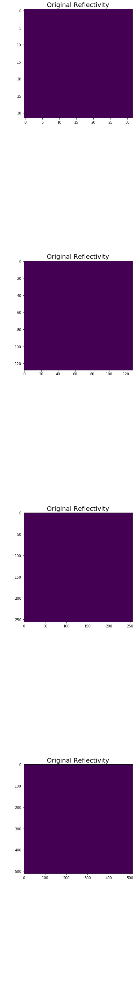
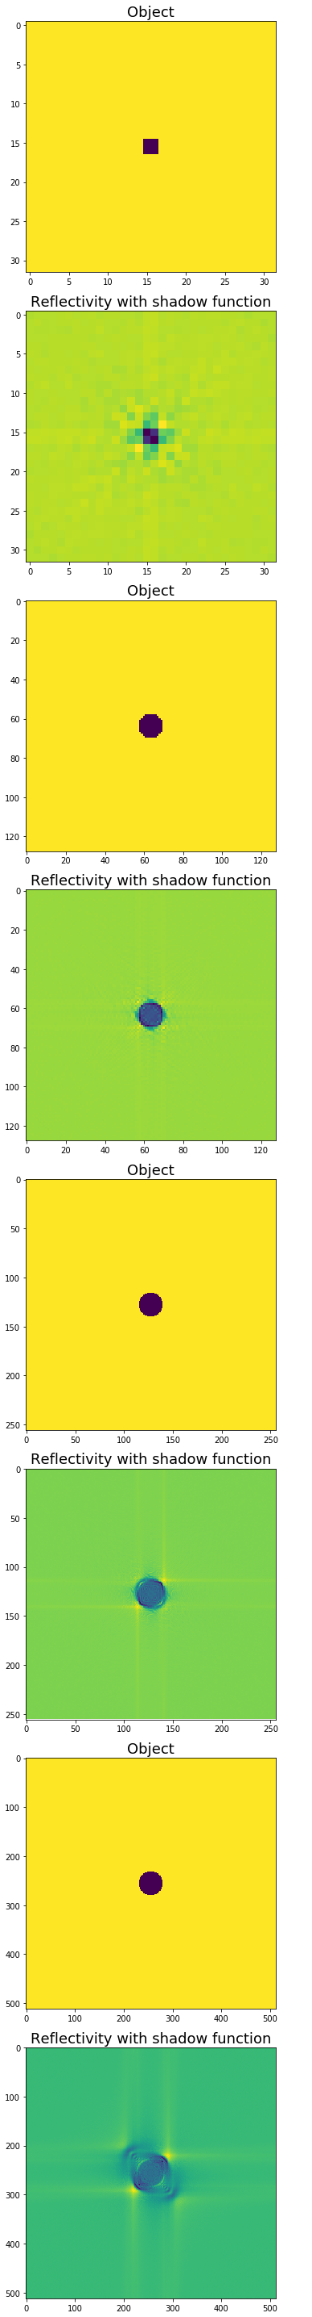
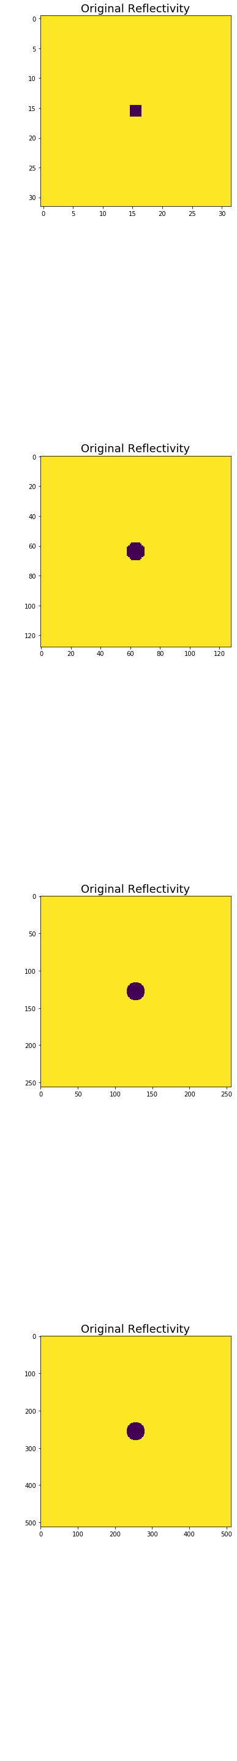
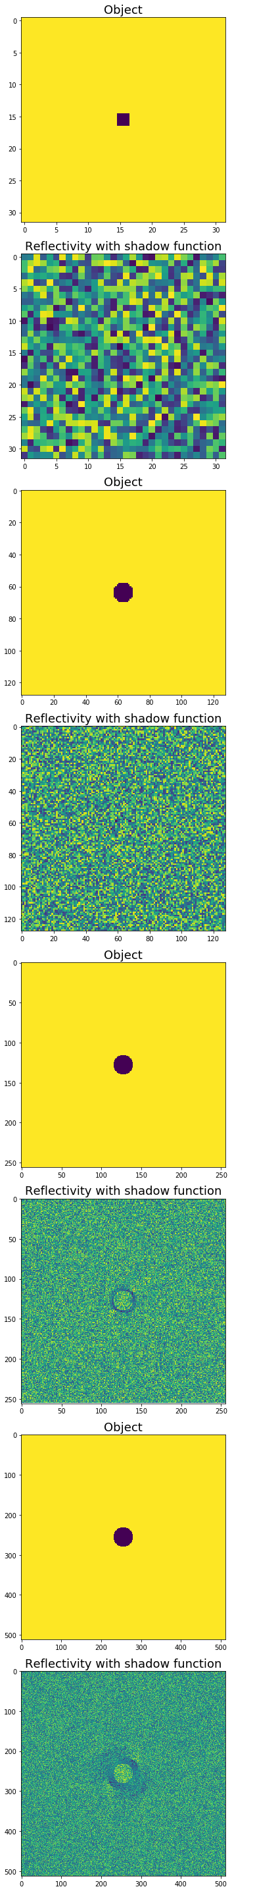
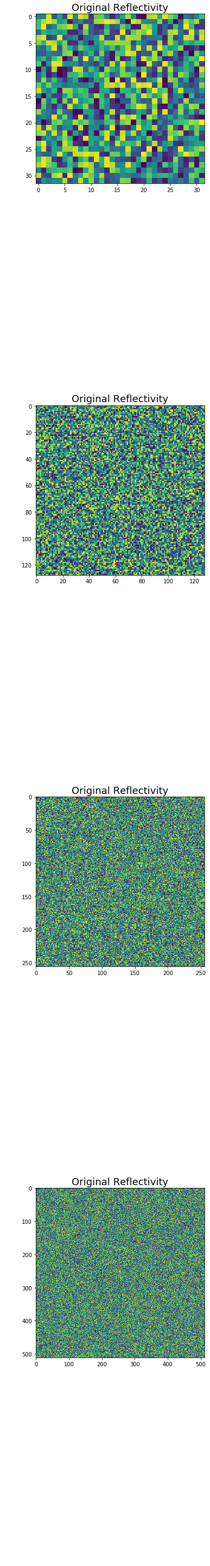
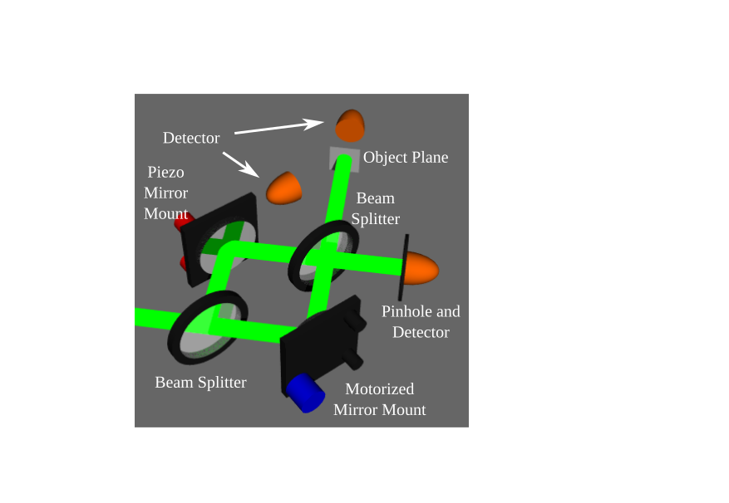
IPSII Shadow Simulations
Carter F. Day, Jarom S. Jackson, Dallin S. Durfee
Brigham Young University
Abstract
Using projected laser interference patterns, a new imaging method is being developed that circumvents conventional limitations. "Shadows" are cast in the patterns when imaging objects with a significant axial extent. Simulations are being run to determine the effects of these shadows on the resulting image.
White object on
white background
Black object on
white background
Random object on
random background
Results
(Left) For a 32 by 32 pixel image, the inverse transform shows an object of some kind, but definitions are blurry. As the resolution is increased, the inverse transform shows a clearer object with more precise definitions. Most notably, even with a uniform color scheme (uniform reflectivity) an image of the object is viewed primarily due to the “shadows” the object casts when projecting the interference pattern. The same goes for a noisy object with a noisy background. Where normally an image would appear the same as the reflectivity, contours and definitions are seen because of the IPSII method.
32x32
Results
Background
IPSII (Interference Pattern Structured Illumination Imaging) is a unique method which uses the reflected light of projected interference patterns on an object to determine its Fourier coefficients. From the coefficients an inverse transform is performed to mathematically recreate an image of the object. However, objects with depth create areas in the projected light where there is no interference, resulting in "shadows". We believe that these shadows can help us to see definitions in the image where it otherwise would appear uniform.
128x128
Future Work
Fix unknown bug in our code that led to asymmetries in reconstructed images.
Experimental verification
256x256
Method
To simulate IPSII, thousands of images were made using POV-Ray (a 3D raytracing software). These images contained a cylinder with two distant light sources (representing the laser beams) casting shadows at opposing angles around the cylinder against a white background. Once the cylinder was stripped away from each image, leaving only the shadows behind, these files could be used in the recreation of the image of the cylinder. Each shadow pixel was defined as a zero in the inverse transform because it represents a lack of interference. The resulting transform is shown for different resolutions and different reflectivities.
Current Setup
512x512
Funded by: BYU College of Physical and Mathematical Sciences
Notes:
<number>

